Slide 1

Game Of life by Jhon Horton Conway
Recreated by – Harshit Bagga

Slide 2
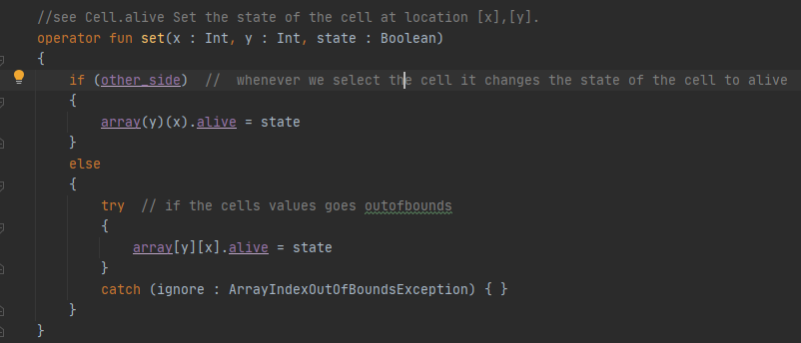
Set()

Slide 3
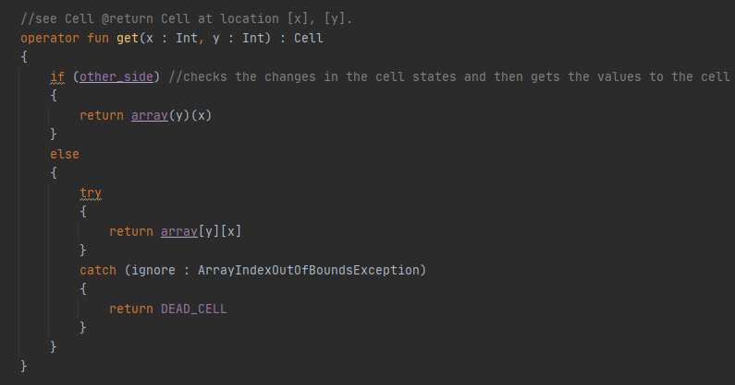
Get()

Slide 4
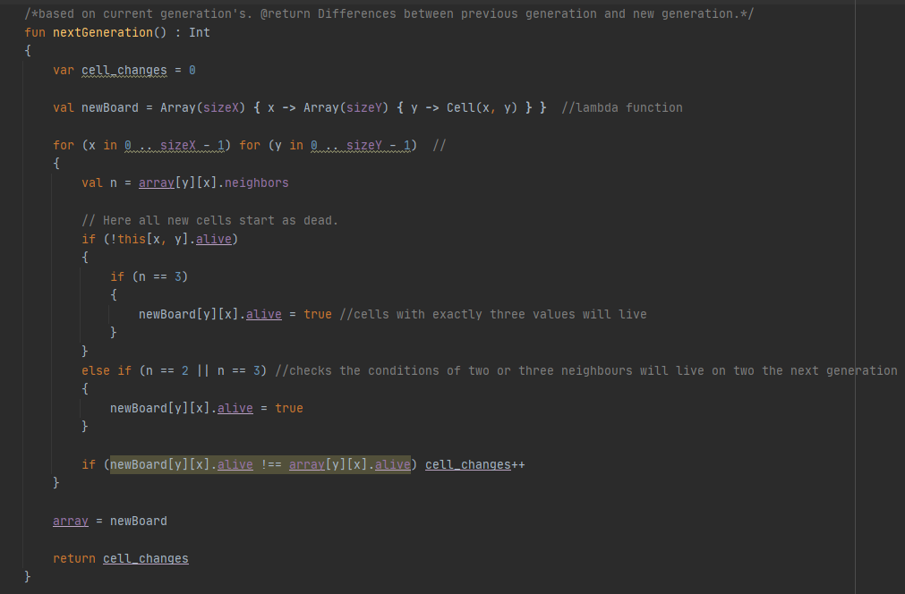
NextGeneration()

Slide 5
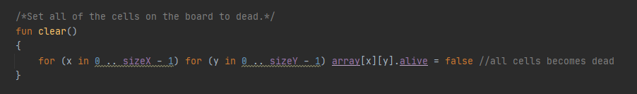
Clear()

Slide 6
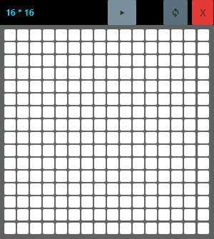

UI with TornadoFX

